Slide 1
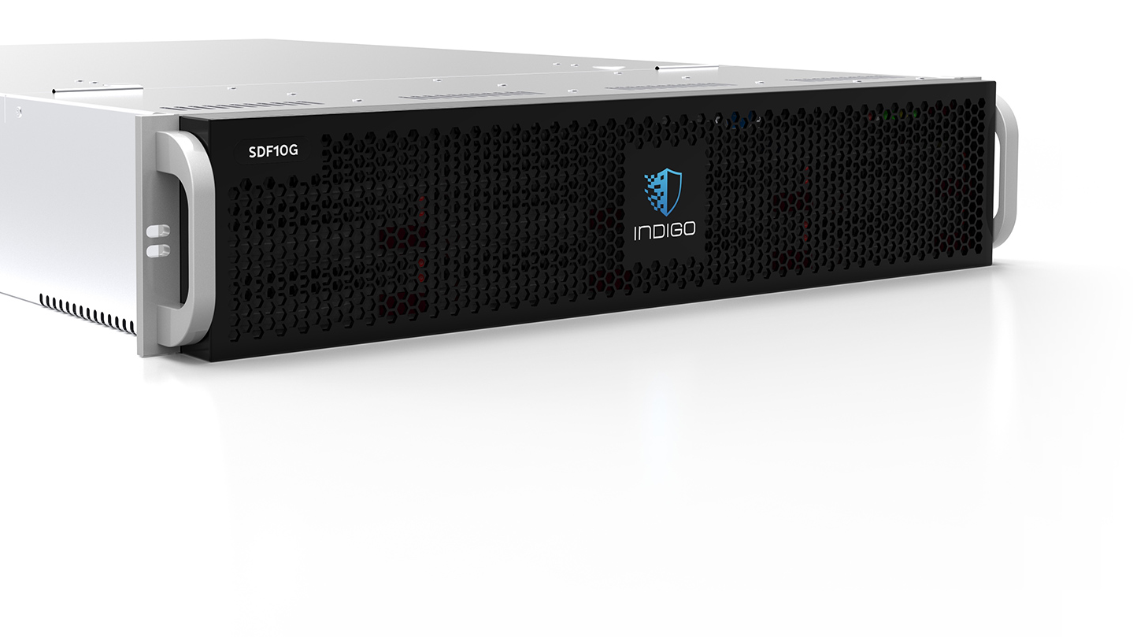
Analysis of Software Defined Network Firewall (SDF)

Slide 2
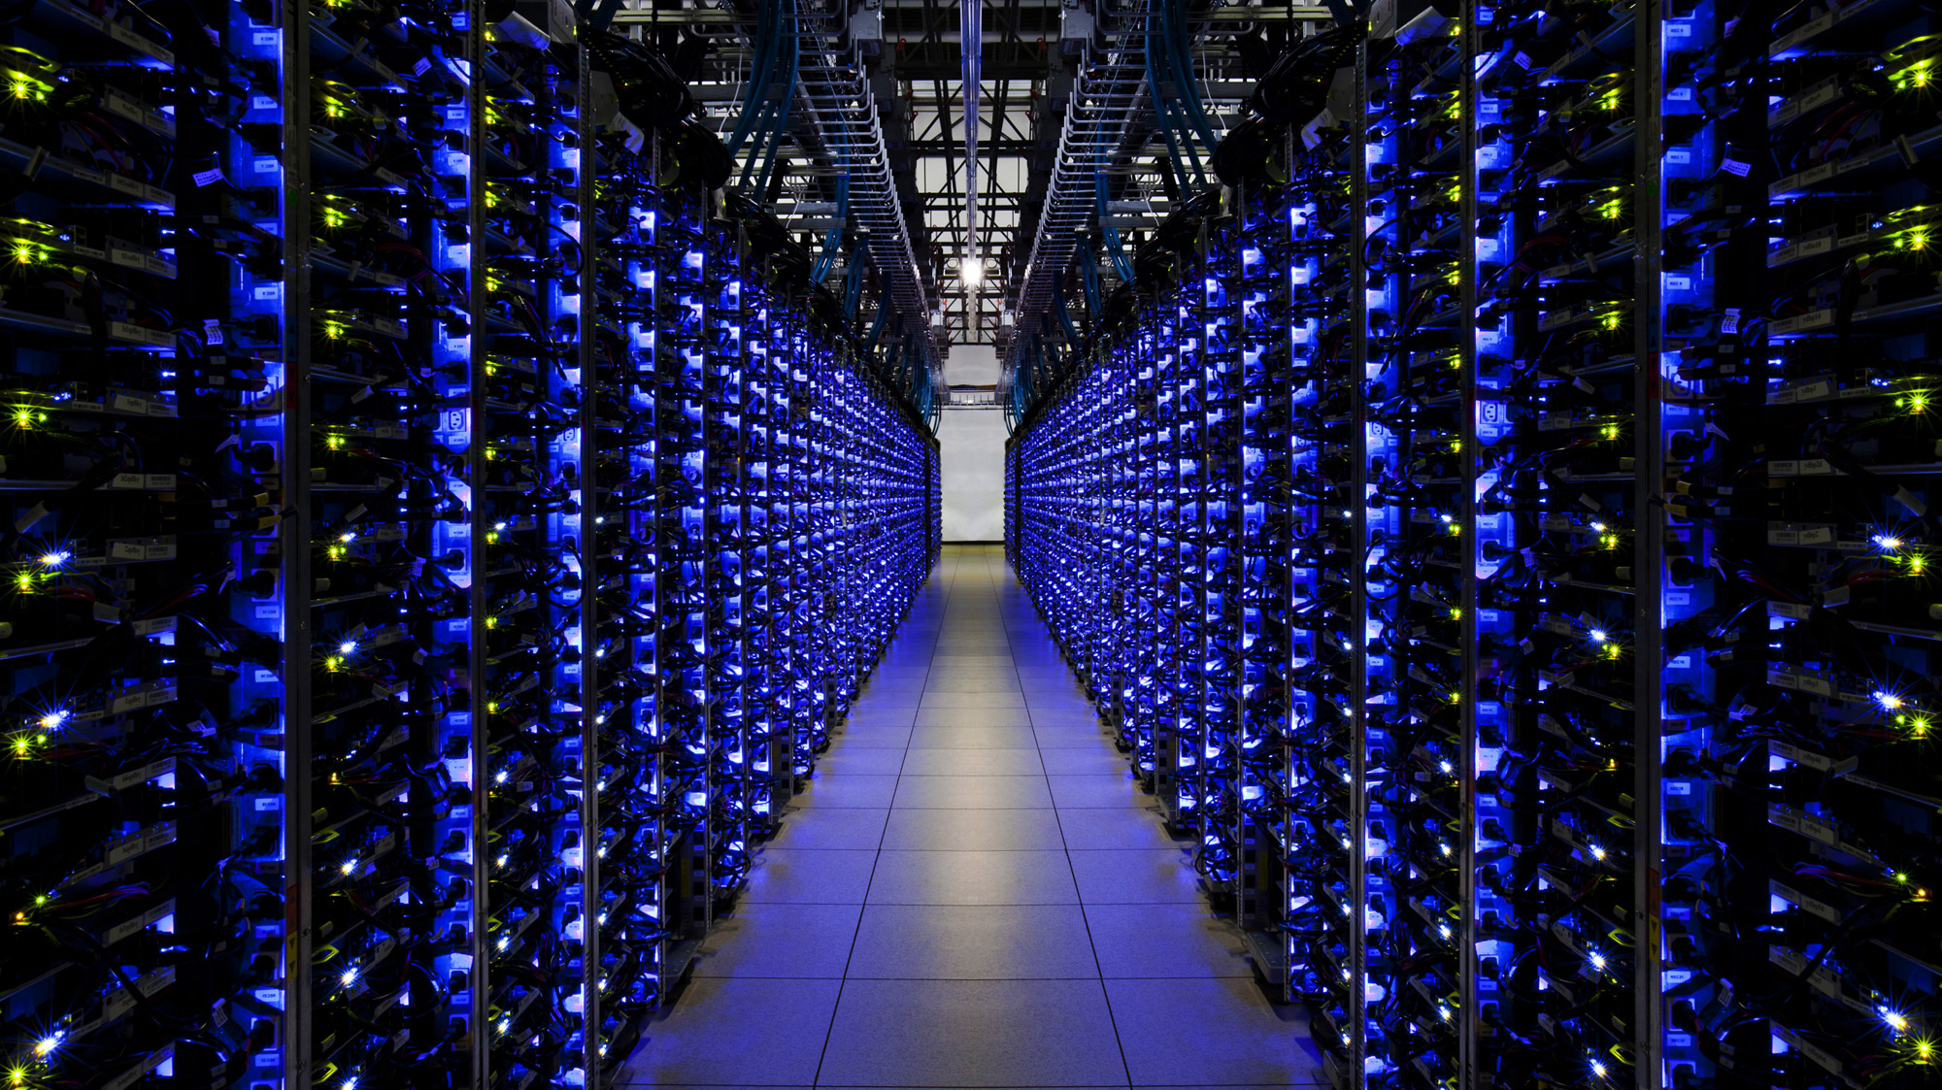
Software Defined Networking

Slide 3
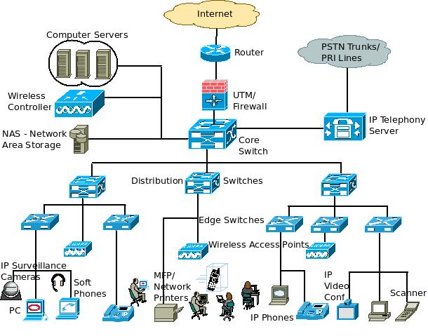
Limitations of Current Networks
Switches

Slide 4
Limitations of Current Networks
Enterprise networks are difficult to manage
“New control requirements have arisen”:
Greater scale
Migration of VMS
How to easily configure huge networks?
Notes:
validate responsiveness as demand varies according to user needs
firewalls and load balancers
eliminate vulnerability and exposure between users and applications

Slide 5
















Limitations of Current Networks
Old ways to configure a network
App
App
App
Operating
System
Specialized Packet Forwarding Hardware
App
App
App
Operating
System
App
App
App
Specialized Packet Forwarding Hardware
Operating
System
App
App
App
Specialized Packet Forwarding Hardware
Operating
System
Specialized Packet Forwarding Hardware
App
App
App
Operating
System
Specialized Packet Forwarding Hardware

Slide 6

Limitations of Current Networks
Feature
Feature
Many complex functions baked into infrastructure
OSPF, BGP, multicast, differentiated services, Traffic Engineering, NAT, firewalls, …
Million of lines of source code
Operating
System
Specialized Packet Forwarding Hardware
Billions of gates
Cannot dynamically change according to network conditions

Slide 7
Idea: An OS for Networks
Closed
App
App
App
Operating
System
Specialized Packet Forwarding Hardware
App
App
App
Operating
System
App
App
App
Specialized Packet Forwarding Hardware
Operating
System
App
App
App
Specialized Packet Forwarding Hardware
Operating
System
Specialized Packet Forwarding Hardware
App
App
App
Operating
System
Specialized Packet Forwarding Hardware

Slide 8















Idea: An OS for Networks
Control Programs
Network Operating System
App
App
App
Operating
System
Specialized Packet Forwarding Hardware
App
App
App
Operating
System
App
App
App
Specialized Packet Forwarding Hardware
Operating
System
App
App
App
Specialized Packet Forwarding Hardware
Operating
System
Specialized Packet Forwarding Hardware
App
App
App
Operating
System
Specialized Packet Forwarding Hardware
Notes:
How do we redefine the architecture to open up networking infrastructure and the industry!
By bring to the networking industry what we did to the computing world

Slide 9
Idea: An OS for Networks
Control Programs
Network Operating System
Simple Packet Forwarding Hardware
Simple Packet Forwarding Hardware
Simple Packet Forwarding Hardware
Simple Packet Forwarding Hardware
Simple Packet Forwarding Hardware
Notes:
The key is to have a standardized control interface that speaks directly to hardware
A whole network is like a big machine

Slide 10
Idea: An OS for Networks
“NOX: Towards an Operating System for Networks”
Software-Defined Networking (SDN)
Control Programs
Global Network View
Network Operating System
Control via forwarding
interface
Protocols
Protocols
Notes:
A remote controller has control of a switch’s forwarding decisions

Slide 11
Software Defined Networking
No longer designing distributed control protocols
Much easier to write, verify, maintain, …
An interface for programming
NOS serves as fundamental control block
With a global view of network
Notes:
The scope, the design goal
No need for distance-vector routing if you have a global view – compute dijkstra directly

Slide 12
OpenFlow
Control Path (Software)
Data Path (Hardware)

Slide 13
OpenFlow
OpenFlow Controller
OpenFlow Protocol (SSL/TCP)
Control Path
OpenFlow
Data Path (Hardware)
OpenFlow/SDN tutorial, Srini Seetharaman, Deutsche Telekom, Silicon Valley Innovation Center
Notes:
Leverages hardware inside most switches today (ACL tables)

Slide 14


OpenFlow Switching
Controller
OpenFlow Client
PC
Software
Layer
OpenFlow Table
MAC
src
MAC
dst
IP
Src
IP
Dst
TCP
sport
TCP
dport
Action
Hardware
Layer
*
*
*
5.6.7.8
*
*
port 1
port 1
port 2
port 3
port 4
5.6.7.8
1.2.3.4
14

Slide 15
OpenFlow Table Entry
Rule
Action
Stats
Packet + byte counters
Forward packet to port(s)
Encapsulate and forward to controller
Drop packet
Send to normal processing pipeline
…
Switch
Port
MAC
src
MAC
dst
Eth
type
VLAN
ID
IP
Src
IP
Dst
IP
Prot
TCP
sport
TCP
dport
+ mask
Notes:
The earliest prototype… just to get an idea

Slide 16



OpenFlow Usage
Alice’s code
Controller
Alice’s code:
Simple learning switch
Per Flow switching
Network access control/firewall
Static “VLANs”
Her own new routing protocol: unicast, multicast, multipath
Home network manager
Packet processor (in controller)
IPvAlice
Alice’s Rule
OpenFlow Switch
PC
Decision?
OpenFlow
Protocol
Alice’s Rule
OpenFlow Switch
Alice’s Rule
OpenFlow Switch
Notes:
Table entries can be updated

Slide 17

OpenFlow
OpenFlow (OF) is considered one of the first software-defined networking (SDN) standards. It originally defined the communication protocol in SDN environments that enables the SDN Controller to directly interact with the forwarding plane of network devices such as switches and routers, both physical and virtual (hypervisor-based)
Just need to update firmware
Essential to the implementation of SDN

Slide 18

Centralized/Distributed Control
“Onix: A Distributed Control Platform for Large-scale Production Networks”
Centralized Control
Distributed Control
Controller
Controller
OpenFlow
Switch
OpenFlow
Switch
Controller
OpenFlow
Switch
OpenFlow
Switch
OpenFlow
Switch
OpenFlow
Switch
Notes:
Partition, aggregation, consistency, durability
Asynchronous but eventually consistent

Slide 19
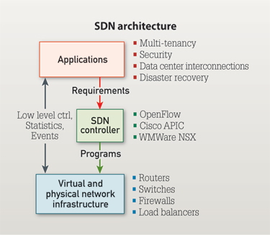
SDN Architecture

Slide 20
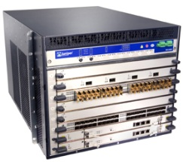
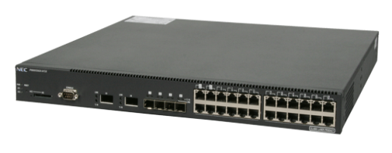
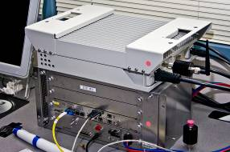
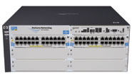
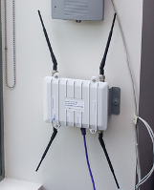

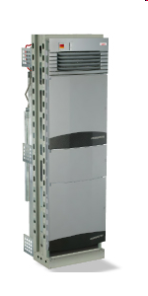

Current status of SDN
Hardware support
Juniper MX-series
NEC IP8800
WiMax (NEC)
HP Procurve 5400
Netgear 7324
PC Engines
Pronto 3240/3290
Ciena Coredirector
More coming soon...
Notes:
Not only switches but other network components

Slide 21
Current status of SDN
Industry support
Google built hardware and software based on the OpenFlow protocol
VMware purchased Nicira for $1.26 billion in 2012
IBM, HP, NEC, Cisco and Juniper also are offering SDNs that may incorporate OpenFlow, but also have other elements that are specific to that vendor and their gear.
Notes:
Nicira offers a way to build scale out virtualized networks and uses OpenFlow, but only as a small aspect of its controller product.
100+ institutions around the world are using openflow

Slide 22
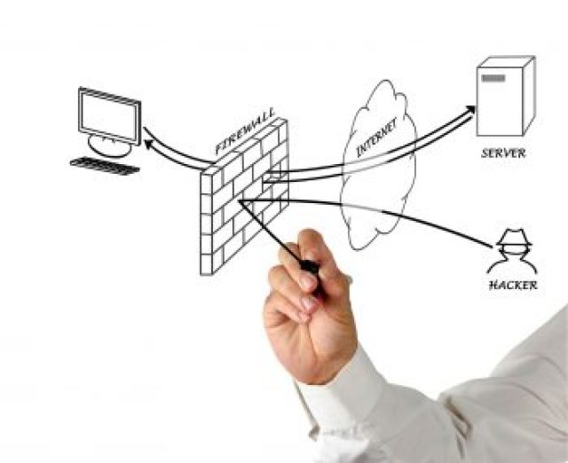
Software-defined network (SDN) based firewall

Slide 23
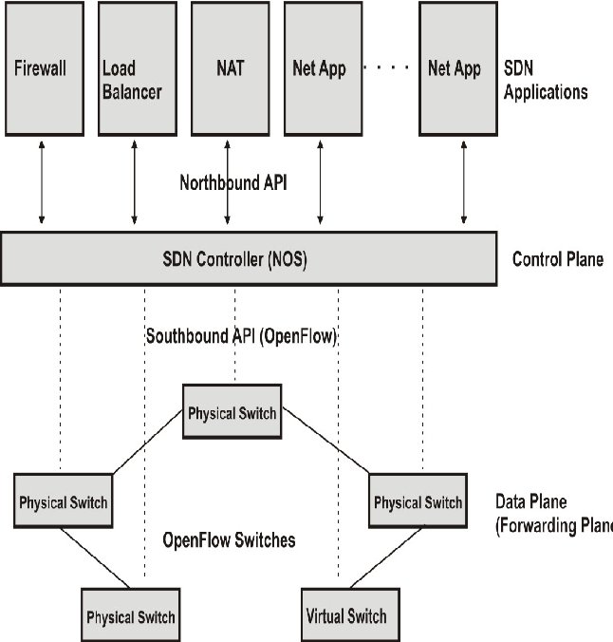
Programmable firewall using Software Defined Networking

Slide 24
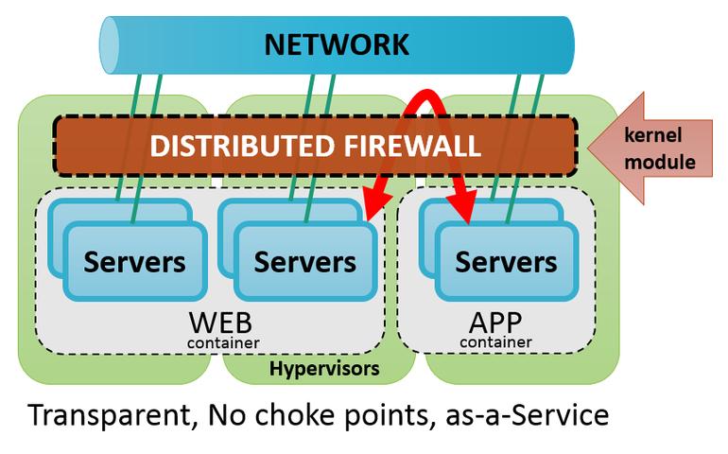
Moving virtualization from servers to the network: Distributed SDN Firewall

Slide 25
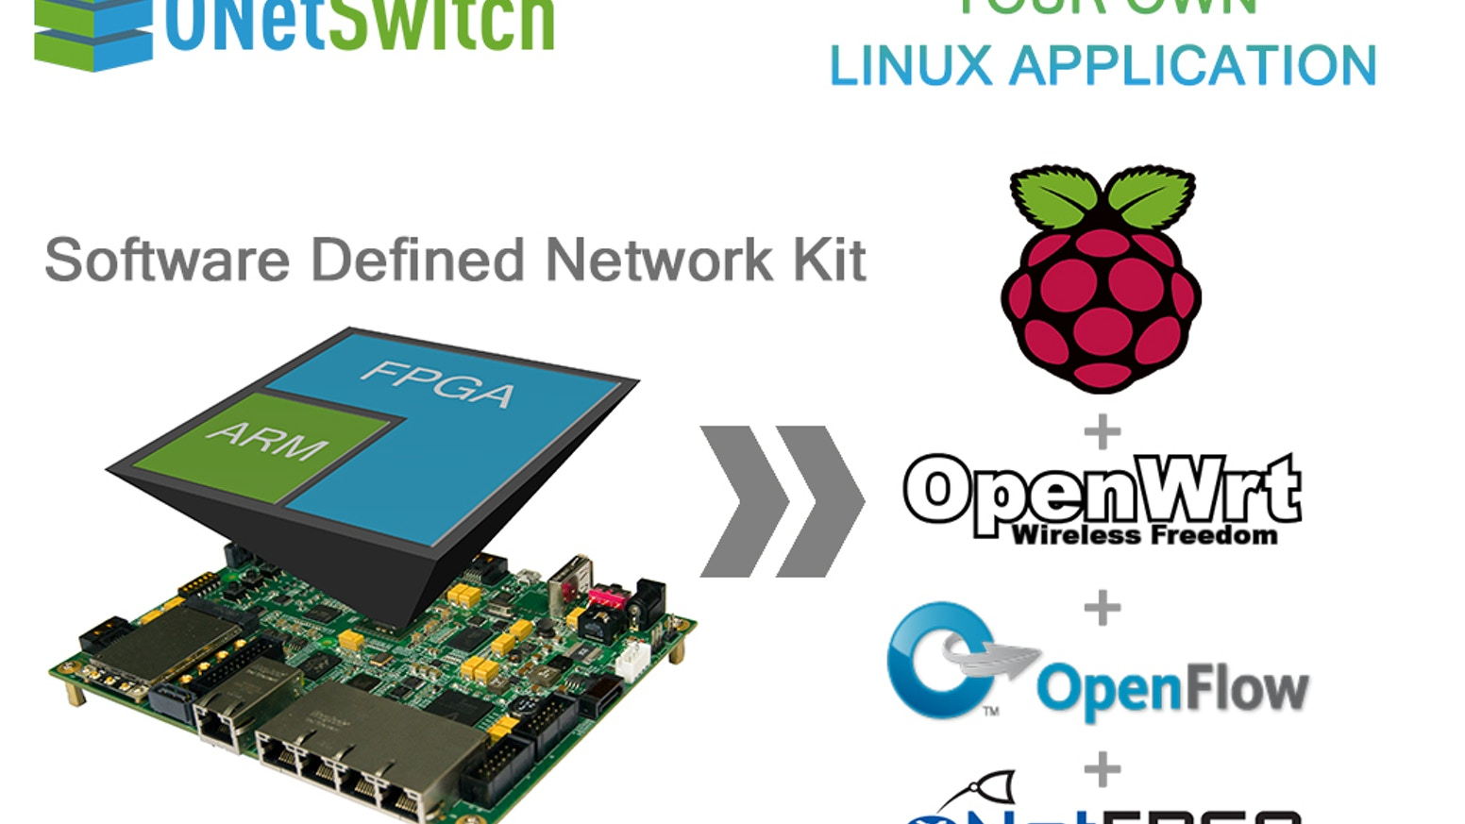
ONetSwitch: Open Source Hardware forSDN Firewall

Slide 26
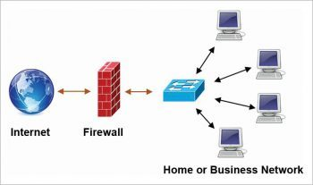
SDN architecture
SDN architecture is basically focused on allowing network administrators to manage and control the whole network through a software program based controller. This goal is achieved through the separation of the data plane and control plane, which simplifies the networking services.
Traditional firewall

Slide 27
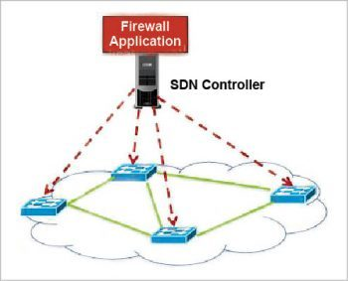
SDN based firewall
Internal traffic is not seen and cannot be filtered by a traditional firewall.
An SDN based firewall works both as a packet filter and a policy checker.
The first packet goes through the controller and is filtered by the SDN firewall.
The subsequent packets of the flow directly match the flow policy defined in the controller.
The firewall policy is centrally defined and enforced at the controller.

Slide 28
Implementing an SDN based firewall
A firewall is used as a barrier to protect networked computers by blocking malicious network traffic generated by viruses and worms. In this article, I have implemented an SDN based firewall by writing code for an SDN controller in Python. More specifically, I have written code to add firewall rules to a POX controller. The implementation of an SDN based firewall requires the installation of Mininet and the POX controller. Both are open source tools and are freely available.

Slide 29
Conclusion
SDN based firewall, which has many advantages over the traditional variants.
The firewall in SDN is controlled by the central controller rather than the individual device.
Also, it is a software based firewall so there is no need for any extra device. The updating rules are also easy to make.SDN can be expanded beyond actual match/action paradigm. For example, it could integrate middleboxes or programmable custom packet processors. This integration could offers new services like on the fly encryption, transcoding, or traffic classification. This require coordination, consensus and vendor support.
In control plane, the composing and coupling of heterogeneous components are still difficult. For example, compose application using Beacon, POX or Floodlight simultaneously.
Finally, remark that SDN is a tool. The research community can use this tool
to create new innovative services and applications.

Slide 30


Slide 31

Thank you for being patient!
Syam S
Computer Network Engineering
Atria Institute Of Technology

